Slide 1
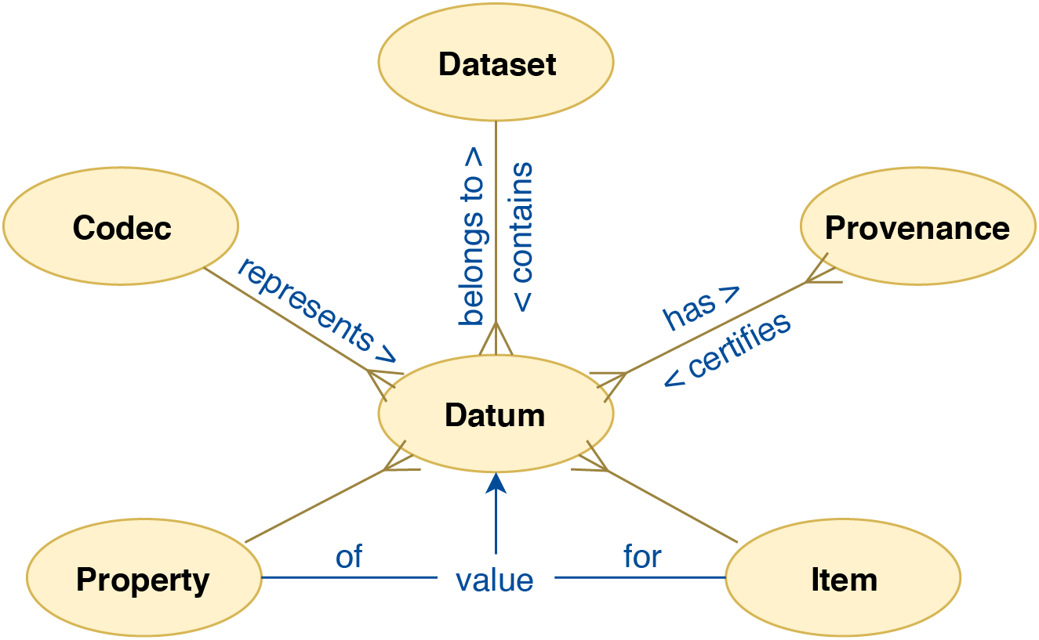
Data model

Slide 2
towiesin@class:/opt/class.kwarc.info/info.mathhub.data$ sudo docker-compose run --rm -e PGPASSWORD=postgres --workdir /data/sql mhd time psql -h postgres -d postgres -U postgres --single-transaction -f /data/sql/data.sql
Starting infomathhubdata_postgres_1 ... done
Detected postgres backend, waiting for server to connect.
python: can't open file 'manage.py': [Errno 2] No such file or directory
COPY 1
COPY 11759677
COPY 11759677
COPY 11759677
COPY 11759677
COPY 11759677
COPY 11759677
COPY 11759677
COPY 11759677
COPY 11759677
COPY 11759677
COPY 11759677
real 27h 32m 39s
user 0m 59.21s
sys 0m 39.61s
towiesin@class:/opt/class.kwarc.info/info.mathhub.data$

Slide 3
Datum
~ the atomic concept in the system.
Every datum belongs to a dataset. It gives a value for some property of some item. It has a provenance and is represented with a codec. We can not eliminate the possibility of encountering more than one value for a property of an item—this could happen due to a computational error.

Slide 4
Dataset
~ a single research product and consists of a set of single data items (datums).
It combines information about the items, the properties each item has, which codecs are used to encode the actual values, and finally, the provenances of all data contained in it. The datasets can overlap non-trivially.

Slide 5
Item
~ single mathematical object, represented in the system simply by a unique identifier.
Examples of these include groups, graphs, lattices, and other complex mathematical objects. An item can belong to more than one dataset: the Petersen graph naturally appears in both previously mentioned censuses.

Slide 6
Provenance
~ information on how each datum was produced.
Note that a datum can have more than one provenance. This happens whenever the value of a property of an item is computed independently in different datasets.

Slide 7
Property
~ a mathematical invariant of a mathematical structure.
An example of a such a property is orthogonality of a matrix. A property can be encoded in several ways (recall the case of integers in LMFDB, where three different encodings are used). Encodings of objects (such as the graph6 representation for graphs) are a special case of properties.

Slide 8
Codec
~ a pair of partial mappings between mathematical values of properties and the values represented in the database.
A codecs combines the concepts of
– a mathematical type,
– condition operators, and
– a database type
with interface components such as a presenter (value display, possibly via a view) and condition widgets.

Slide 9
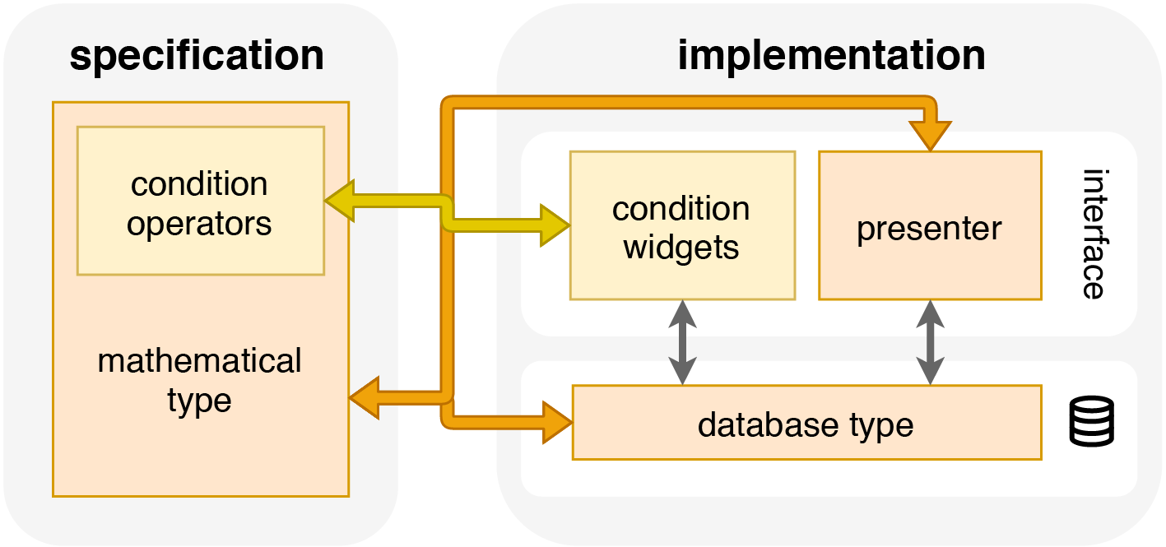
Codec, a diagram

Slide 10
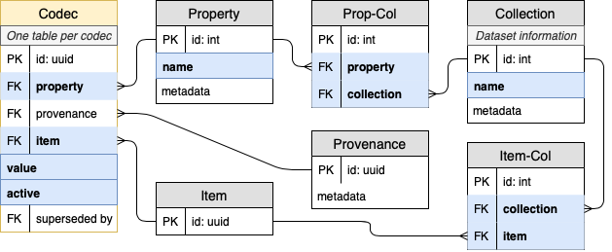
Database structure
Blue = B-Tree Index

Slide 11
Statistics
Dataset size: N, Number of properties: P
Table | Number of rows | Columns | Number of cells
Provenance | 1 | PK, created, metadata | 1 * 3 = 3
Items | N | PK | 1 * N = N
Item-Collection (ManyToMany) | N | PK, item_id, collection_id | 3 * N = 3N
Codec (1 per property) | P * N | PK, value, item_id, prop_id, prov_id, active | 6 * P * N = 6PN
Σ | (2 + P) N + 1 |  | (4 + 6P)N + 3

Slide 12
Statistics (Concrete)
“Small Groups”: N ≈ 11 * 10^6, P = 9
Table | Number of rows | Columns | Number of cells
Provenance | 1 | PK, created, metadata | 3
Items | 11 * 10 ^ 6 | PK | 11 * 10 ^ 6
Item-Collection (ManyToMany) | 11 * 10 ^ 6 | PK, item_id, collection_id | 33 * 10 ^ 6
Codec (1 per property) | 99 * 10 ^ 6 | PK, value, item_id, prop_id, prov_id, active | 594 * 10 ^ 6
Σ | 121 * 10 ^ 6 + 1 |  | 638 * 10 ^ 6 + 3

Slide 13
How To Import
Method 1: Using Django’s ORM
items = [Item(u) for u in uuids]
model.objects.bulk_create(items)
Under the hood: INSERT INTO ... VALUES (...);
Escapes internally
Can batch (i.e. split into several sub-queries)
But: Needs ORM-object-instantiation (slow)

Slide 14
How To Import
Method 2: Using COPY FROM
# escape values as csv into a temporary byte stream
stream = StringIO()
for v in values:
stream.write("\t".join([encode(v[p]) for p in props]))
# reset the stream back to the beginning
stream.seek(0)
# insert values into the database
with connection.cursor() as cursor:
cursor.copy_from(table, stream, separator="\t")
COPY ... FROM ... WITH DELIMITER AS E'\t' NULL AS E'\N';
Needs explicit escaping (tedious to work out once)
Needs a lot of memory
But: A lot faster than the previous query

Slide 15
How To Import
Method 3: Using SQL + COPY FROM
# serialize data into csv
csv = open("data.csv", "w")
for v in values:
stream.write("\t".join([encode(v[p]) for p in props]))
# then later run:
\copy ... FROM './data.csv' WITH DELIMITER AS E'\t' NULL AS E'\N';
Still needs a manual escaping
No reliance on Django / Python during importing
But: Memory needs limited

Slide 16
SELECT
I.id as id,
"T_basis".value as "property_value_basis",
"T_k".value as "property_value_k",
"T_n".value as "property_value_n",
"T_S".value as "property_value_S",
"T_R".value as "property_value_R"
FROM
mhd_data_item as I
JOIN mhd_data_itemcollectionassociation as CI ON I.id = CI.item_id
AND CI.collection_id = 1
LEFT OUTER JOIN mhd_data_listasarray_standardint as "T_basis" ON I.id = "T_basis".item_id
AND "T_basis".active AND "T_basis".prop_id = 1
LEFT OUTER JOIN mhd_data_standardint as "T_k" ON I.id = "T_k".item_id
AND "T_k".active AND "T_k".prop_id = 2
LEFT OUTER JOIN mhd_data_standardint as "T_n" ON I.id = "T_n".item_id
AND "T_n".active AND "T_n".prop_id = 3
LEFT OUTER JOIN mhd_data_standardbool as "T_S" ON I.id = "T_S".item_id
AND "T_S".active AND "T_S".prop_id = 4
LEFT OUTER JOIN mhd_data_standardbool as "T_R" ON I.id = "T_R".item_id
AND "T_R".active AND "T_R".prop_id = 5
ORDER BY
"property_value_k" ASC, "property_value_n" ASC, "property_value_S" ASC, "property_value_R" ASC

Slide 17
SELECT
... -- same as previous slide
FROM
mhd_data_item as I
JOIN mhd_data_itemcollectionassociation as CI ON I.id = CI.item_id
AND CI.collection_id = 1
LEFT OUTER JOIN mhd_data_listasarray_standardint as "T_basis" ON I.id = "T_basis".item_id
AND "T_basis".active AND "T_basis".prop_id = 1
LEFT OUTER JOIN mhd_data_standardint as "T_k" ON I.id = "T_k".item_id
AND "T_k".active AND "T_k".prop_id = 2
LEFT OUTER JOIN mhd_data_standardint as "T_n" ON I.id = "T_n".item_id
AND "T_n".active AND "T_n".prop_id = 3
LEFT OUTER JOIN mhd_data_standardbool as "T_S" ON I.id = "T_S".item_id
AND "T_S".active AND "T_S".prop_id = 4
LEFT OUTER JOIN mhd_data_standardbool as "T_R" ON I.id = "T_R".item_id
AND "T_R".active AND "T_R".prop_id = 5
WHERE
"T_k".value < 3
ORDER BY
"property_value_k" ASC, "property_value_n" ASC, "property_value_S" ASC, "property_value_R" ASC

